Slide 1



DRAGIN: Dynamic Retrieval Augmented Generation based on the Information Needs of Large Language Models
Authors:Weihang Su, Yichen Tang, Qingyao Ai, Zhijing Wu, Yiqun Liu
Publisher: ACL 2024
汇报人：张文亮

Slide 2
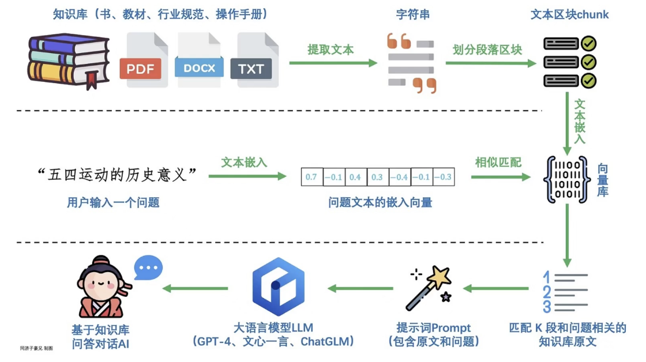
1
Introduction
In recent years, large language models have made significant advancements across various natural language processing tasks.But, these models often produce text that seems coherent and plausible but factually incorrect, a problem commonly known as hallucination.
RAG(Retrieval Augmented Generation) enhances LLMs by retrieving and incorporating relevant information from external databases into the LLMs’ inputs.
自强不息 厚德载物
Central South University
Notes:
检索增强生成模型结合了语言模型和信息检索技术。具体来说，当模型需要生成文本或者回答问题时，它会先从一个庞大的文档集合中检索出相关的信息，然后利用这些检索到的信息来指导文本的生成，从而提高问题回答的准确性及减缓大模型的幻觉问题

Slide 3
1
Introduction
Traditional methods of RAG typically rely on single-round retrieval, using the LLM’s initial input to retrieve relevant information from external corpora. While this method is effective for straightforward tasks, it tends to fall short for complex multi-step tasks and long-form generation tasks .
Dynamic RAG performs multiple times of retrieval during the generation process of LLMs.It includes two steps: identifying the optimal moment to activate the retrieval module (deciding when to retrieve) and crafting the appropriate query once retrieval is triggered (determining what to retrieve)
自强不息 厚德载物
Central South University
Notes:
虽然这种方法在处理简单直接的任务时很有效，但在处理复杂的多步骤任务和长篇生成任务时往往力不从

Slide 4
2
relate work
Method | Overview
IRCoT | Adopts a global augmentation method where retrieval is conducted for each generated sentence, with the latest generated sentence used as the query
RETRO and ICRALM | Define a sliding window and trigger the retrieval module based on a preset number of processed tokens, and the last n tokens are used as the query primarily in determining the optimal timing for retrieval and formulating effective queries when retrieval is triggered
FLARE | Triggers retrieval dynamically when the LLM’s confidence (the generation probability) on the next token is lower than certain thresholds. Last generated Sentence exclude low-probability tokens as the query
自强不息 厚德载物
Central South University
Notes:
例如，IRCoT采用了一种全局增强方法，其中对每个生成的句子都进行检索，并将最新生成的句子用作查询。 RETRO和IC-RALM定义了一个滑动窗口，并根据预设的处理过的标记（token）数量来触发检索模块。当触发检索时，它们主要使用最后n个标记作为查询，以确定检索的最佳时机并制定有效的查询。 当滑动窗口中的 token 数量达到预设的阈值（例如，每处理完一定数量的 token）时，就会触发检索模块。 However, the necessity of retrieval augmentation not only depends on the generation confidence, but also depends on the importance of the token, the semantic of the token, and the influence of each token on subsequent tokens

Slide 5
1
Introduction
deciding when to retrieve
Existing approaches often rely on static rules to decide when to retrieve, neglecting the assessment of necessity and potential risks involved,unnecessary retrieval augmentation may introduce irrelevant or noisy data to LLMs which could jeopardize the quality of the outputs
On the other hand, conducting retrieval augmentation will inevitably increase the time and computation cost of LLM inference, such cost is unworthy if LLMs can generate correct outputs by themselves.
.
determining what to retrieve
The strategies for deciding what to retrieve typically limit themselves to the LLM’s most recent sentence or the last few tokens, while the LLM’s information needs may span across the entire context.
自强不息 厚德载物
Central South University
Notes:
This approach may not capture the model’s real-time information needs since the LLM’s information needs may actually be related to terms that span the entire context

Slide 6
4
Method
The author a new framework, DRAGIN, Dynamic Retrieval Augmented Generation based on the Information Needs of LLMs .
For the timing of retrieval:
Author propose RIND: Real-time Information Needs Detection,considers the LLM’s uncertainty about its own generated content, the influence of each token on subsequent tokens, and the semantic significance of each token.
For the formulation of retrieval queries:
Author propose QFS: Query Formulation based on Self-attention, which innovates query formulation by leveraging the LLM’s self-attention.
自强不息 厚德载物
Central South University
Notes:
To overcome these limitations, 如上文所述，大多数现有的动态检索增强生成（RAG）框架都是基于静态、预定义的规则来触发检索模块的。 这个框架是专门设计来根据文本生成过程中大型语言模型（LLM）的信息需求，决定何时以及检索什么内容的 考虑到大语言模型（LLM）对自身生成内容的不确定性、每个 token 对后续 token 的影响，以及每个 token 的语义重要性

Slide 7
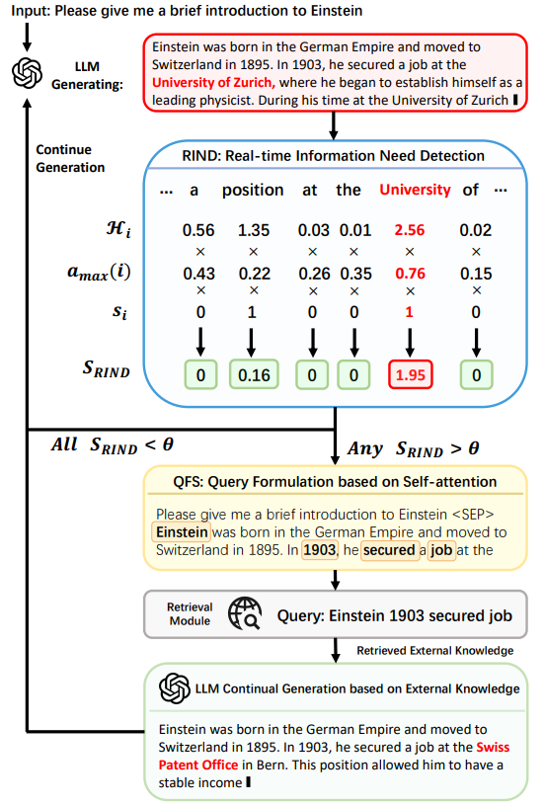





4
Method
Real-time Information Need Detection
This method refines the retrieval activation process by evaluating not only the uncertainty of each token, but also its semantic contribution and the impact on the following context.
自强不息 厚德载物
Central South University
Notes:
p;(υ):这表示模型在生成序列时，在第i个位置生成 tokenv 的概率。模型会从一个词汇表 V中选择一个 token，pi(v)是生成该 token 的概率。 AIj两个 token ti和 t,j(其中i< j)之间的注意力值
amax(i)通过查找所有j>i中的最大 4i.j，确定 token t;的最大注意力值 amax(i) - H~i~：每个词的熵值，衡量其不确定性。熵高表示模型对这个词不确定。
- a~max~(i)：模型的自注意力权重，表示该词对生成上下文的重要性。
- s~i~：该词是否有语义意义，过滤掉停用词 (如 "the", "at")。 检索增强的必要性不仅取决于生成置信度，还取决于标记的重要性、标记的语义以及每个标记对后续标记的影响 该方法不仅通过评估每个标记的不确定性，而且通过评估其语义贡献和对后续上下文的影响来细化检索激活过程 当LLM生成每个token时，RIND开始量化每个token的不确定性

Slide 8
4
Method
Query Formulation based on Self-attention:
The query formulation steps:
(1) Extract the attention scores of the last Transformer layer Ai = {a_{i,1}, a_{i,2}, ..., a_{i,i−1}} for each token t_{i} in T, where a_{i,j} represents the attention score assigned by t_{i} to t_{j};
(2) Sort A_{i} in descending order to identify the top n tokens with the highest attention scores;
(3) Find the words corresponding to these tokens from the vocabulary and arrange them according to their original order in the text;
(4) Construct the query Q_{i} using the words from these top n tokens, ensuring the query reflects the most relevant aspects of the context as determined by the LLM’s self-attention mechanism.
自强不息 厚德载物
Central South University
Notes:
一旦确定了进行检索增强的位置，RAG框架的下一步是制定一个查询，从外部数据库检索必要的信息，以继续生成LLM 由于LLM对ti的生成是基于其对整个先前上下文的解释，因此注意力权重反映了在生成ti时模型对每个标记的自评估重要性。QFS方法根据这些标记的注意力得分来确定它们的优先级，选择前n个标记来构造查询。 触发的位置即SRIND的值大于给定阈值

Slide 9
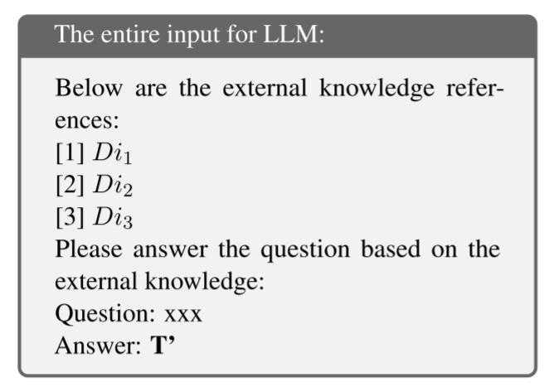

4
Method
Continue Generation after Retrieval
The QFS module creates the query and utilizes an off-the-shelf retrieval model to retrieve relevant information from external knowledge bases. Suppose the retrieved documents are denoted as D_{i1}, D_{i2}, and D_{i3}. Upon successful retrieval, the next step of the dynamic RAG framework is to integrate this external knowledge into the LLM’s generation process
prompt template
自强不息 厚德载物
Central South University
Notes:
T是LLM生成的原始序列，ti是RIND识别需要外部知识的标记 在掌握了Di1、Di2和Di3的基础上，我们采用了精心设计的提示模板3，其结构如下 假设在随后的位置j，RIND再次检测到LLM需要外部知识。在这种情况下，在位置j再次触发QFS模块以生成新的查询，检索新的文档集Dj1、Dj2和Dj3以替换Di1、Di2和Di3。然后，LLM将根据新检索到的文档，按照相同的过程，从位置j继续生成。

Slide 10
4
Method
自强不息 厚德载物
Central South University
Notes:
T是LLM生成的原始序列，ti是RIND识别需要外部知识的标记 在掌握了Di1、Di2和Di3的基础上，我们采用了精心设计的提示模板3，其结构如下 假设在随后的位置j，RIND再次检测到LLM需要外部知识。在这种情况下，在位置j再次触发QFS模块以生成新的查询，检索新的文档集Dj1、Dj2和Dj3以替换Di1、Di2和Di3。然后，LLM将根据新检索到的文档，按照相同的过程，从位置j继续生成。

Slide 11
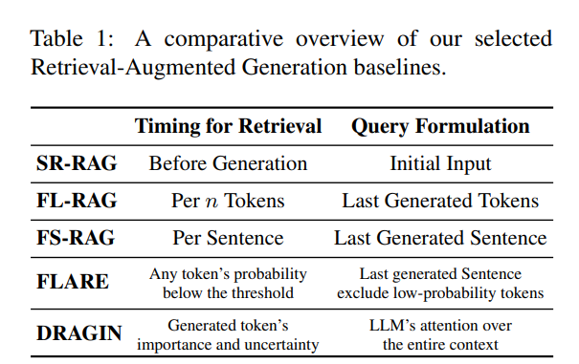
5
Experiments
Datasets
2WikiMultihopQA and HotpotQA | Evaluate the RAG framework’s ability to answer complex questions that require multihop reasoning
IIRC dataset | Evaluate the RAG framework’s ability in reading comprehension task
StrategyQA dataset | Evaluate the commonsense reasoning capabilities of DRAGIN and other baselines
自强不息 厚德载物
Central South University
Notes:
选择的检索增强生成基线的比较概述

Slide 12
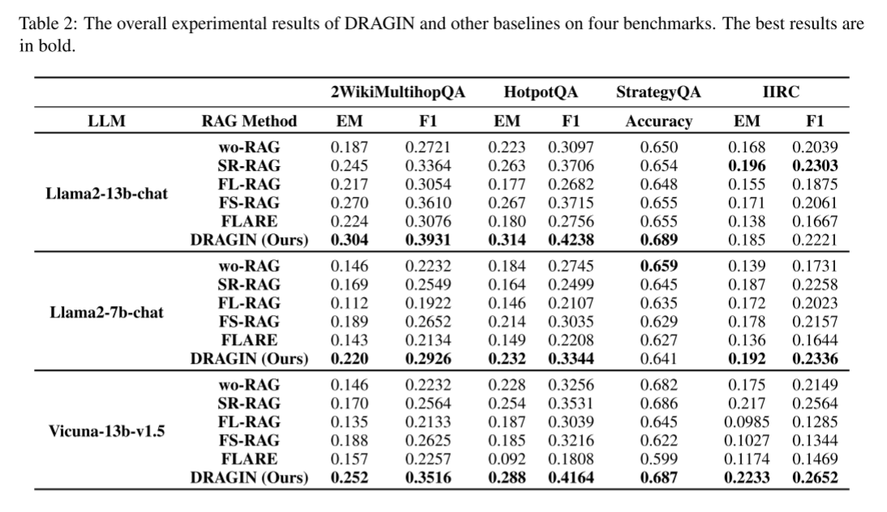
5
EXPERIMENTS
自强不息 厚德载物
Central South University
Notes:
DRAGIN和其他基线在四个基准上的总体实验结果。最佳结果以粗体显示。 wo-RAG LLM直接回答问题，无需RAG SR-RAG（单轮RAG）。基于初始问题从外部语料库中检索相关段落。然后将检索到的段落添加到LLM的输入中 FL-RAG 一种多轮检索增强方法，每n个令牌触发一次检索模块。在上一个令牌窗口中生成的令牌将用作查询 FS-RAG 一种多轮检索增强方法，每句触发一次检索模块。最后生成的句子被用作查询。 FLARE 每次遇到不确定标记时触发检索。当检索模块被触发时，最后生成的没有不确定标记的句子被定义为查询。 Vicuna是开源领域最强最著名的大语言模型，是UC伯克利大学的研究人员联合其它几家研究机构共同推出的一系列基于LLaMA微调的大语言模型、开源的聊天语言大模型

Slide 13
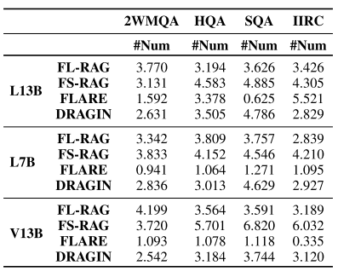
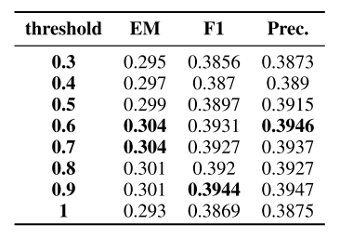
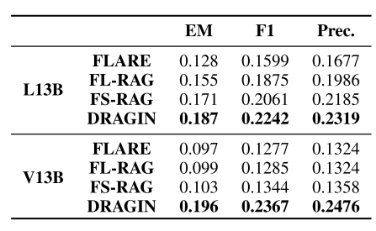
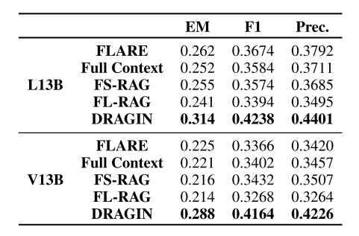
5
EXPERIMENTS
Frequency of retrieval module activation
Comparasion between different threshold of RIND
The influence of the ‘When to Retrieve’ decision
The influence of the query formulation methods
自强不息 厚德载物
Central South University
Notes:
Exact Match (EM)：
EM衡量的是模型输出的答案与真实答案是否完全一致 都使用最后一个完整句子作为查询 我们将触发检索的时间标准化为RIND

Slide 14
6
CONCLUSION
Conclusions:
The author propose DRAGIN, a dynamic RAG framework tailored to address the real-time information needs of LLMs during text generation. By integrating RIND for timely retrieval activation and QFS for precise query formulation, DRAGIN significantly outperforms existing dynamic RAG methods across various knowledge-intensive benchmarks.
limitations:
the reliance on the selfattention mechanism of Transformer-based LLMs for both Real-time Information Needs Detection (RIND) and Query Formulation based on Selfattention (QFS). While self-attention scores are accessible for all open-source LLMs, it’s important to note that our method is not applicable to certain APIs that do not provide access to the self-attention scores.
自强不息 厚德载物
Central South University

Slide 15
7
Improve
1.The retrieval part is optimized using a knowledge graph
2.Adaptive retrieval threshold adjustment
3.Consider replacing the stop word list with a model
自强不息 厚德载物
Central South University
Notes:
使用知识图谱去检索 动态调整阈值 BM25（Best Matching 25）是一种基于概率模型的文档检索排序算法

Slide 16

Thanks For Listening
Notes:
近似：在这篇论文中，不再优化SOTA采样器和邻居搜索器以减少执行延迟（在此基础上进行改进），而是决定通过简单地从“结构化”点云中选择具有适当索引的点，从而近似采样点以及它们的邻居
启发，借鉴2D图像的方法用于3D点云很有创造性 而和SOTA的采样和邻居搜索完全不同

